Slide 1

Dystopias

Slide 2
Aims and Objectives:
To explore the history of dystopian texts
Identify the difference between a post-apocalyptic and dystopian texts
Investigate the themes each text studied raises and the relevance to contemporary society
Analyse the values and attitudes in each text

Slide 3
Definitions
Post-Apocalyptic fiction: a work of fiction set in a world or civilisation after a potentially existential catastrophe or disaster.
The genre (a subset of the dystopian genre) is categorised by four narrative sequences:
WARNING
There are signs of impending doom.
The threat is related to moral weakness, or corruption.
The warning is heeded by some, ignored by others.
CALAMITY
The disaster occurs.
The disaster reveals a truth.
Some are saved (the believers? the good?). Many are lost.
COLLAPSE
Society descends into barbarism.
There is a struggle for survival.
Old ways and values are tested.
RECOVERY
The world recovers (or doesn’t).
A new future is revealed.
Values are clarified in the ending.

Slide 4
Definitions
Dystopian fiction: a work of fiction describing an imaginary place where life is extremely bad because of deprivation or oppression or terror.
A dystopia is an unpleasant (typically repressive) society, often propagandised as being utopian. Dystopian texts speculate and depict a negative view of the way the world is supposedly going in order to provide urgent propaganda for a change in direction.
Dystopian fiction mostly always explores the themes of:
political control over society,
totalitarianism,
loss of rights and free will,
“unification,”
loss of independent thought,
Extreme censorship

Slide 5
Definitions
Dystopian texts serve as warnings. They often come from modern societal fears and anxieties over inequality, climate change, government power, global epidemics, etc.
They serve as cautionary tales and warnings through speculation about the way that society is going, or could go.
In the dystopian genre there is always a society that controls its people, usually through deprivation and terror, no matter how “perfect” it seems at first glance.

Slide 6
ATAR Syllabus points
Reflect on their own and others’ texts by:
analysing and evaluating how different attitudes and perspectives underpin texts.
questioning the assumptions and values in texts.
Investigate and evaluate the relationships between texts and contexts by:
undertaking close analysis of texts.
examining how each text relates to a particular context or contexts
comparing the contexts in which texts are created and received.

Slide 7
Utopias and Dystopias
Utopias are societies that are “perfect.” The specific attributes of a utopia will vary depending on the culture that creates it. Certain utopias will focus on the relationships between man and nature, others on economic relationships, or theological matters.
Dystopias often highlight a societal concern, demonstrating to the reader the potential consequences of a particular behaviour or trend.

Slide 8
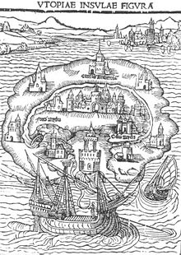
Utopia: (οὐ)"not", topos (τόπος) "place"
Thomas More (1478–1535) published his novel, Utopia in Latin in 1516 as a social-political satire on Catholic monasteries.

Slide 9
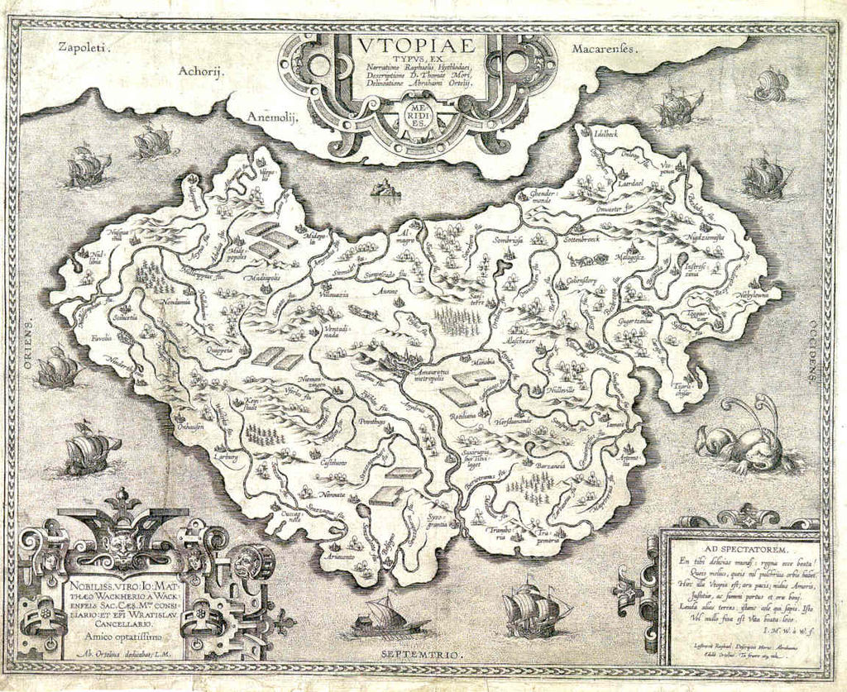
Utopia: Thomas More
Book 1 of Utopia begins as an epistolary, with More communicating with Belgian officials, travellers and Utopian citizens about the new land. More meets a traveller, Raphael Hythlodaeus, who has visited the island of Utopia on Amerigo Vespucci‘s voyages to the Americas.
Book II of Utopia describes the running of the democratic Utopian society told from Raphael’s point of view.

Slide 10
Utopia: Thomas More
The island contains 54 cities. Each city is divided into four equal parts.
Each city has not more 6000 households, each family consisting of between 10 and 16 adults.
People are re-distributed around the households and towns to keep numbers even.
There is no private property on Utopia, all citizens are taught agriculture and trades, they dress the same, and work six hour days.
Slavery is a feature of Utopian life and it is reported that every household has two slaves who wear gold chains. The slaves are either from other countries or are Utopian criminals.
Meals are taken in community dining halls and the job of feeding the population is given to a different household in turn.
Privacy is not regarded as freedom in Utopia; taverns, ale-houses and places for private gatherings are non-existent for the effect of keeping all men in full view, so that they are obliged to behave well.

Slide 11
Plato’s Magnesia (380 BC)
More’s Utopia was inspired by Plato’s utopia, Magnesia, in The Republic, where he explains:
The city will be relatively populous: its number of households is to remain permanently at 5,040.
Property is owned by the state. Each household must produce enough for the island to survive.
Public and private slaves.
Women can’t own land, but can vote and are required to undertake military service.
The constitution allows ‘guardians of the laws,’ men of at least 50 who have been educated for their lives in Magnesia’s laws to act as judges for the population.

Slide 12
Setting a blueprint
While at best, a utopia might resemble the sixth stage of communism, authors of dystopian fiction still follow the blueprint of Plato/More’s utopias in describing:
A lack of crime, violence and poverty
Governance and Political idealism (usually with one fatal flaw in dystopias)
How land and property are allocated
Where and how people work
Social stratification (classes)

Slide 13
Characteristics of a Dystopian society:
The society is an illusion of a perfect, utopian world
Propaganda is used to control the citizens of society
Information, independent thought and freedom are restricted
A figurehead or concept is worshipped by the citizens of a society
Citizens are perceived to be under constant surveillance
Citizens have a fear of the outside world
Citizens live in a dehumanised state
The natural world is banished and distrusted
Citizens conform to uniform expectations: individuality and dissent are bad

Slide 14
Types of Dystopian Control:
Corporate control: one or more corporations control society through products, advertising, or media
Bureaucratic control: Society is controlled by a mindless bureaucracy through red tape, relentless regulations, and government.
Technological control: Society is controlled through technology – computers, robots, science.
Philosophical/religious control: Society is controlled by philosophical or religious ideology often enforced through a dictatorship or theocratic government.

Slide 15
Historical context
Dystopian fiction often reflects the world in which it is created, serving for the most part as a warning for change in the world.
Consider –
1984 and totalitarian regimes (Stalinist Russia).
Brave New World and eugenics.
The Pedestrian and the formation of the CIA and McCarthyism.
The Handmaid’s Tale and religious fundamentalism, Ceausescu’s Romanian ‘pregnancy’ revolution, 1976 Argentinean revolution, Iranian revolution.

Slide 16
For each text...
For each text we read in class, you will need to answer a few questions:
The perspectives on the society that has been depicted in the text (at narrator, author, reader level)
The reading of the text
Values and attitudes shown in the text
The assumptions that underpin the text.

